Slide 1

Corporate Pulse:
How Performance Drives Market Moves

Slide 2
Agenda
01
Business Problem & Approach
02
Analysis & Findings
03
Conclusion
04
Q&A

Slide 3






Meet the Team
Mishil Trivedi
Brendan Wilcox
Arnav Sachdeva
Content Here
You can simply impress your audience andadd a unique zing and appeal to your Presentations. Easy to change colors, photos and Text.
Aryan Sehgal
Rebecca Bubis
Nilay Jaini

Slide 4
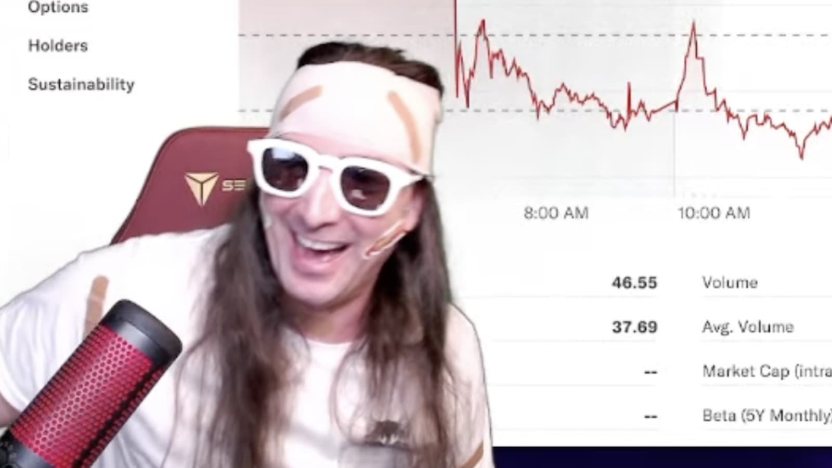


Business Problem
Self-proclaimed “gurus” promote investing by analyzing stock chart shapes, riding trends, and arbitrary timing methods to make quick money
Conversely, hedge funds have found ways to sustainably make profits through a combination of advanced data analytics, economic analysis, and business intuition
Our goal was to make an attempt at the hedge fund approach
But this is extremely challenging

Slide 5


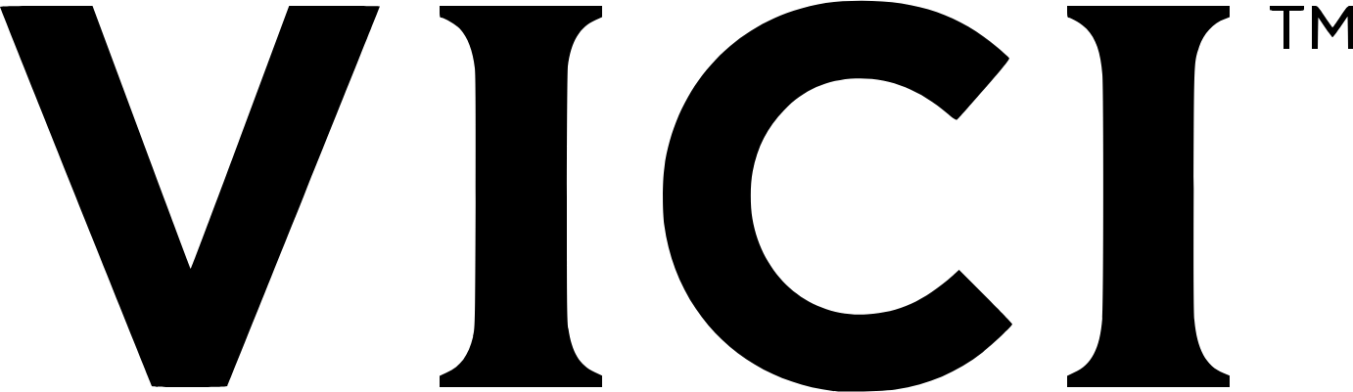
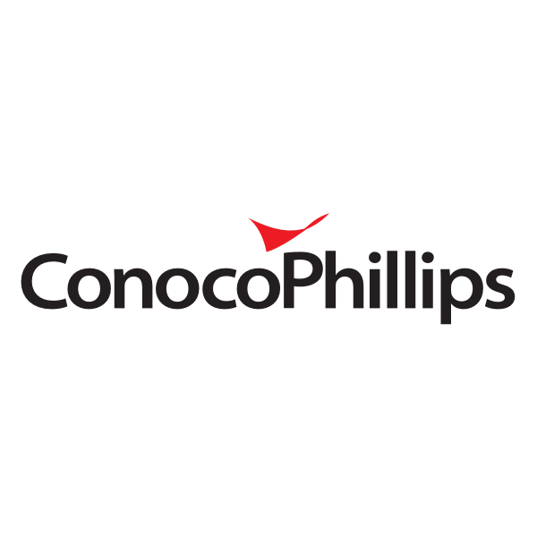


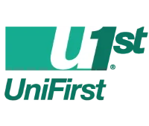



Approach & Goal
Take sample of large, high performing companies and analyze what drives their stock price
Vanguard S&P 500 ETF (VOO)
Take sample of small, high performing companies and analyze what drives their stock price
Vanguard Small-Cap Index Fund Admiral Shares (VSMAX)
What are the unique financial characteristics of VOO and VSMAX companies?
VOO
VSMAX

Slide 6
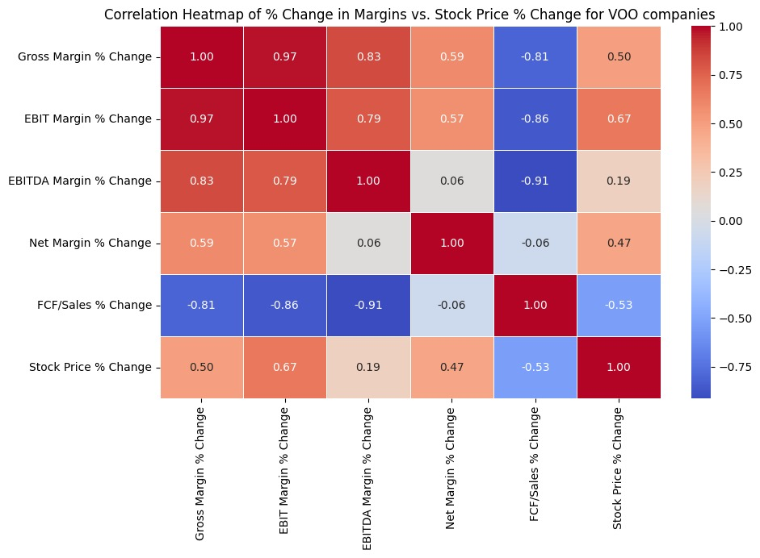
VOO Companies' Margins and Stock Price Correlation Analysis
Gross and EBIT Margin Strength: Strong positive correlation between gross margin (% change) and EBIT margin (% change) with stock price (% change), suggesting higher operating efficiency positively impacts stock prices.
EBITDA and FCF Margins: EBITDA margin shows weaker correlation with stock price changes, while FCF/Sales (% change) is negatively correlated, indicating higher free cash flow may not directly boost stock prices.

Slide 7
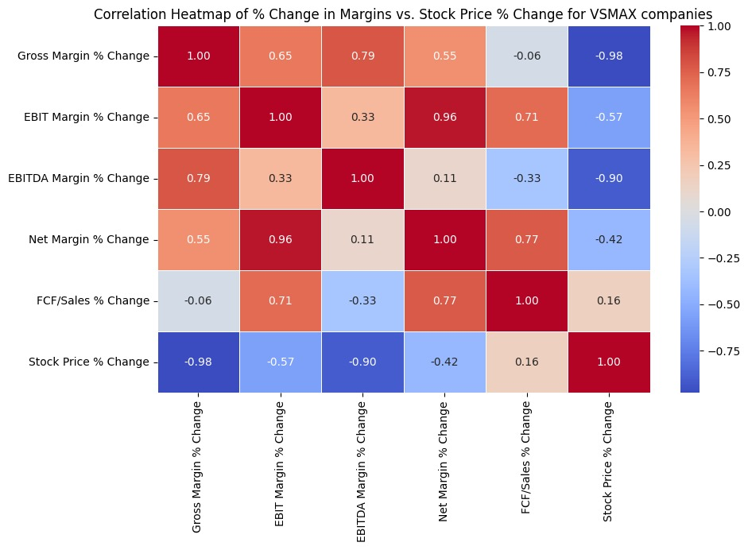
VSMAX Companies' Margins and Stock Price Correlation Analysis
Gross Margin Dominance: Strong negative correlation between gross margin (% change) and stock price (% change) suggests that increasing gross margins are not necessarily tied to stock price increases, which is a unique trend compared to other companies.
EBIT and Net Margins: A significant positive correlation between EBIT and net margin (% change) indicates that higher profitability directly enhances financial performance, but their correlation to stock prices is negative.

Slide 8
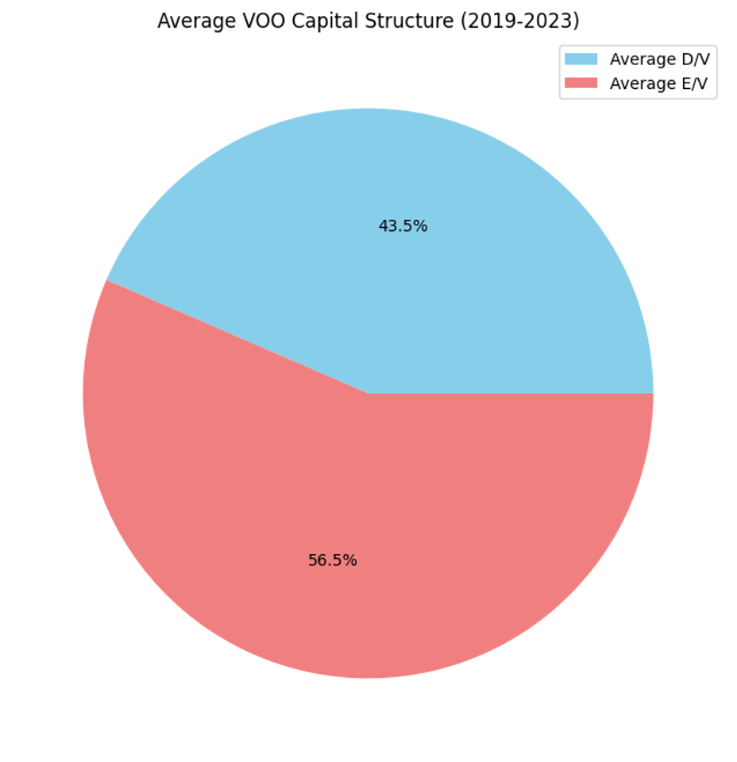
VOO Capital Structure Analysis
Capital Structure: 56.5% equity, 43.5% debt
Balanced Financing: Slightly higher reliance on equity compared to debt
Lower Financial Risk: Less dependency on borrowed funds due to higher equity
Advantage in Uncertainty: More flexibility and reduced burden of fixed debt payments in economic downturns

Slide 9
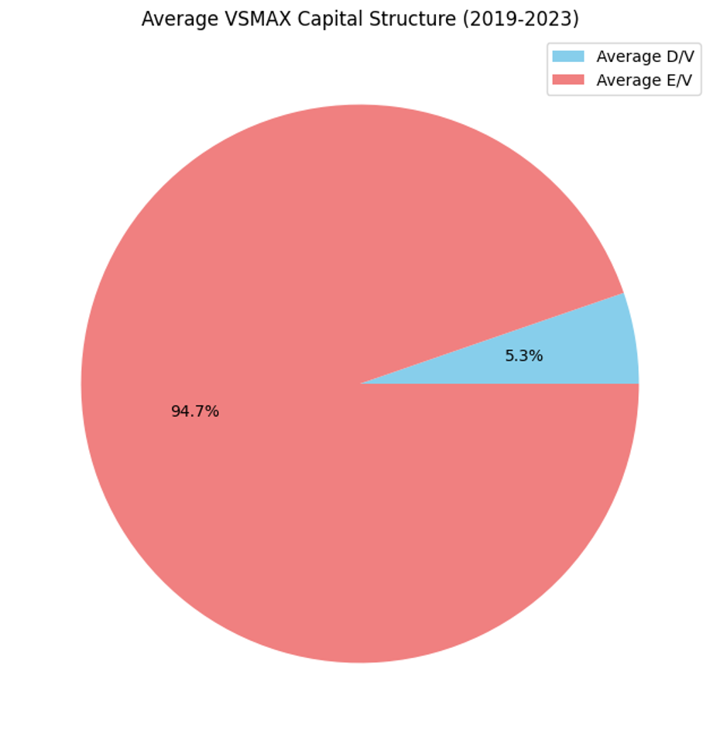
VSMAX Capital Structure Analysis
Capital Structure: 94.7% equity, 5.3% debt
Highly Equity-Driven: Strong reliance on equity financing
Low Financial Risk: Minimal debt indicates lower financial risk
Flexibility and Stability: Greater flexibility during economic fluctuations
Growth Potential: Favorable position for growth due to low debt obligations

Slide 10
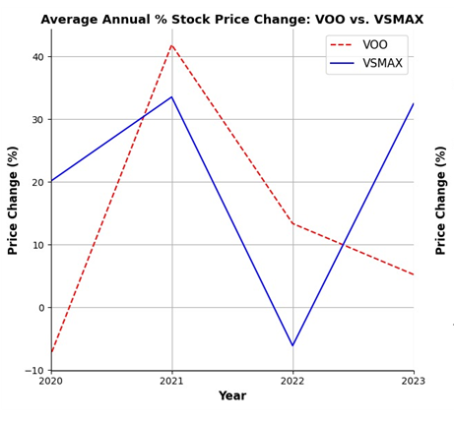
Comparison of Stock Price Volatility: VOO vs. VSMAX (2021-2023)
VSMAX Volatility: VSMAX (small-cap) showed a "V" shaped pattern in price changes: +30% in 2021, -5% in 2022, and +30% in 2023, indicating higher volatility.
VOO Stability : VOO (large-cap) displayed a steadier decline: +40% in 2021, +12% in 2022, and -1% in 2023.

Slide 11
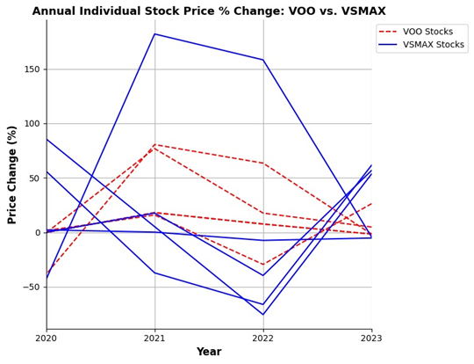
Stock Price Changes by Company
Higher Volatility in VSMAX : VSMAX exhibits higher overall volatility across its stocks compared to VOO.
Significant Stock Performance in VSMAX : One VSMAX stock experienced a remarkable 180% increase, contributing significantly to the portfolio’s growth and volatility in 2021.
Impact on Portfolio Performance: This visualization highlights the individual stocks that influence the overall performance of both portfolios.
Future Analysis Focus: Future analyses will explore correlations between individual stock price changes and their respective portfolio performances.

Slide 12
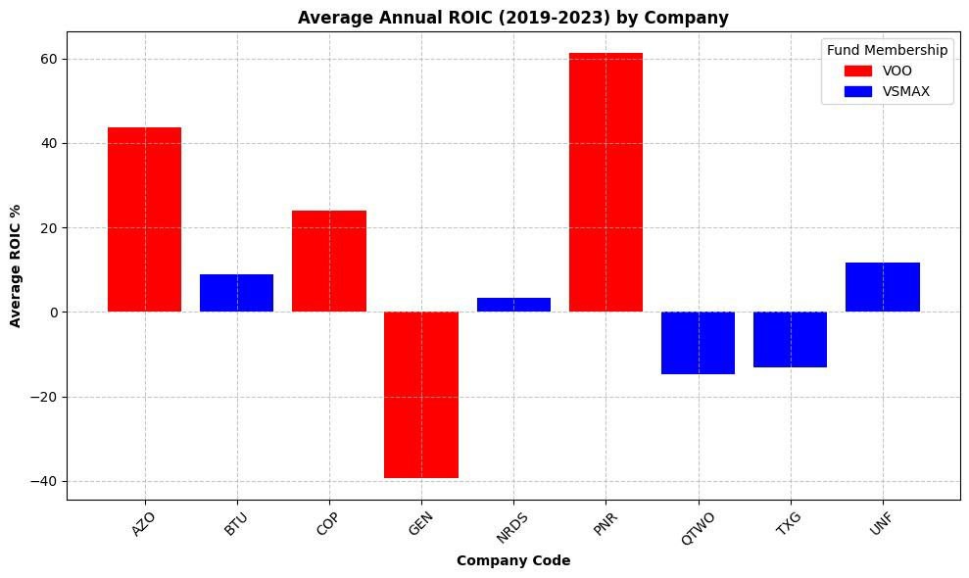
Average ROIC of VOO and VSMAX Companies
1. VOO vs. VSMAX ROIC: VOO companies outperformed VSMAX with an average ROIC of 24% vs. VSMAX’s -1%.
2. VOO Performance: VOO represents large, efficient companies, achieving better profitability and market growth.
3. ROIC Limitations: ROIC isn’t a foolproof metric; GEN’s negative ROIC was driven by contract liabilities typical in subscription-based businesses.

Slide 13
Conclusion
VOO Characteristics
VSMAX Characteristics
1.
VOO companies offer stability and predictable growth, ideal for conservative investors.
2.
VSMAX companies have higher growth potential but come with greater risk, suited for risk-tolerant investors.
Large vs. Small Cap
Portfolio Balance
3.
Large-cap (VOO) provides stability; small-cap (VSMAX) offers higher growth potential and volatility.
4.
Combining both large and small-cap companies can help investors balance stability with growth.
Machine Learning in Finance
Data Leverage
5.
6.
Larger datasets and real-time data improve prediction models using machine learning.
Advanced machine learning can enhance financial modeling accuracy.

Slide 14

Thank you
Questions?

